Slide 1
Dehydrated High-Protein Yogurt
Group 1: Kathryn Atherton, Rohit Chatterjee, Barbara McAnulty, and Hannah O’Neill

Slide 2
INTRODUCTION

Slide 3
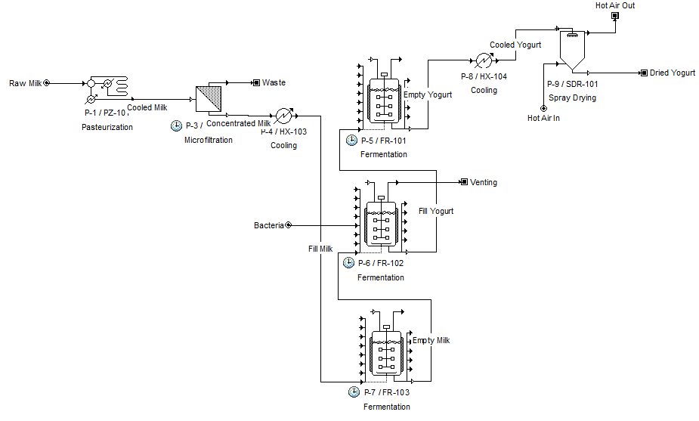
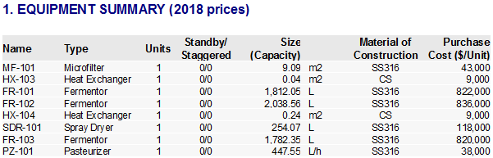
Product and Process Description
Plant Size and Process Flow

Slide 4
INDIVIDUAL OPERATIONS

Slide 5
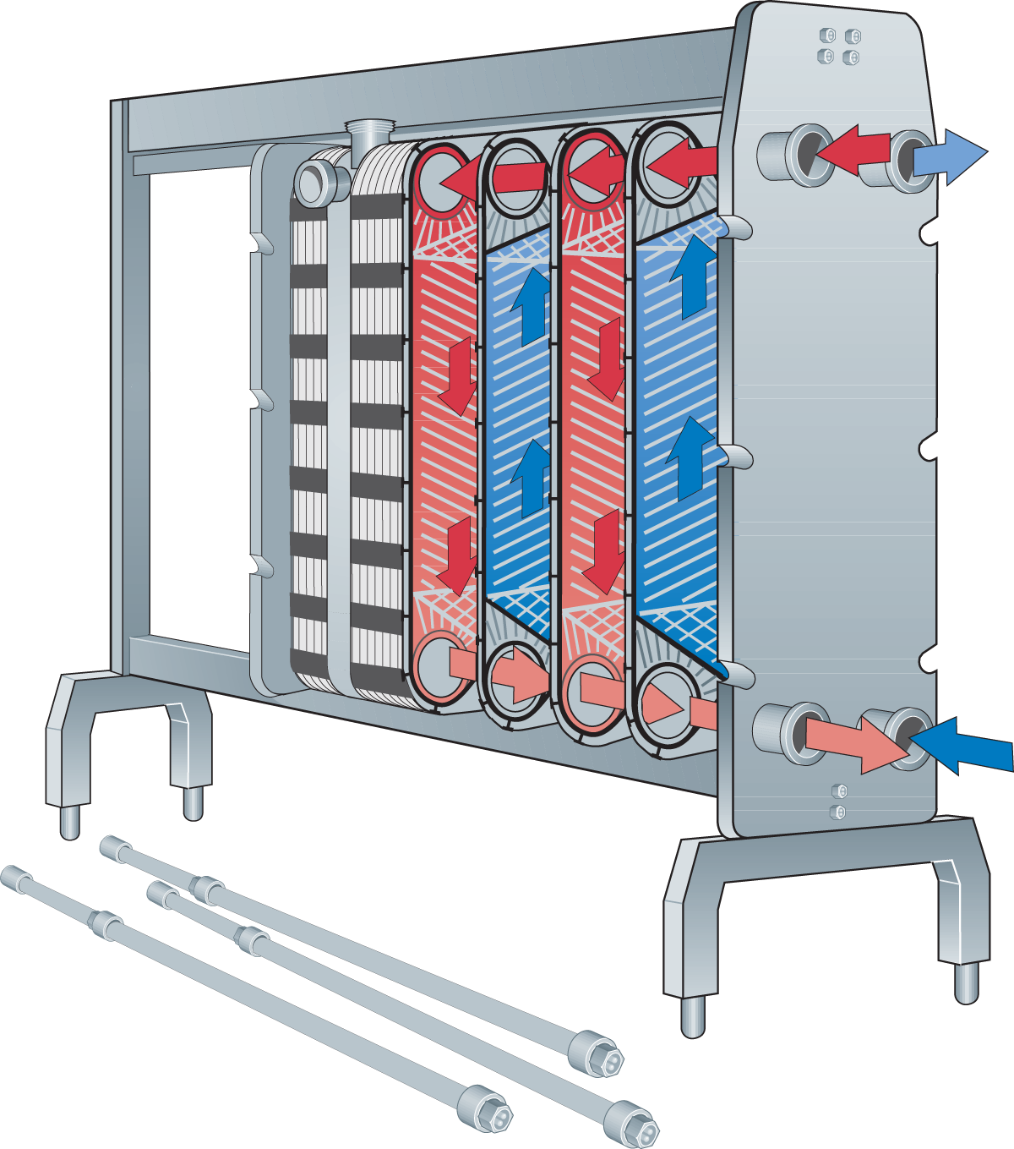
Unit Operation 1: Pasteurization
Overall Goal: Removes pathogens and enzymes that degrade a product
Chosen Method:
Heat Treatment - high temperature causes protein break down
Alternatives:
Hydrostatic Pressure Processing
UV Light
Pulsed Electric Field
Dairy processing handbook

Slide 6
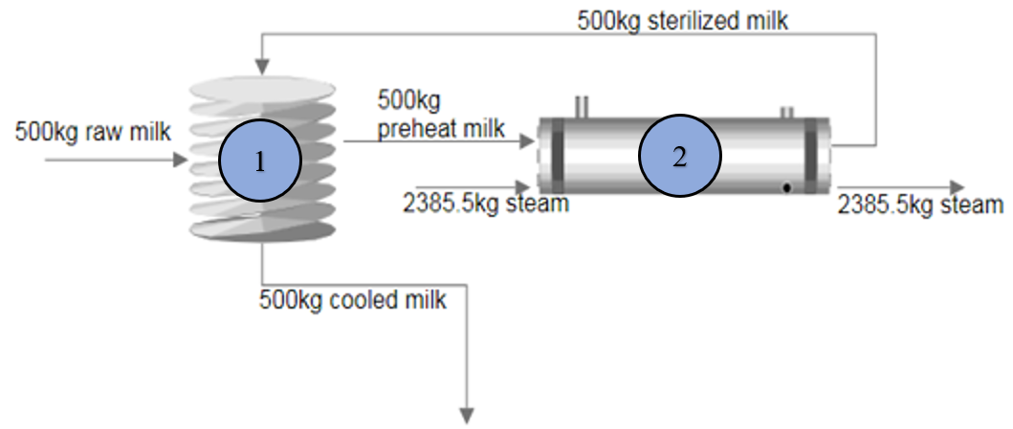
Unit Operation 1: Pasteurization
Process and Equipment Sizing

Slide 7
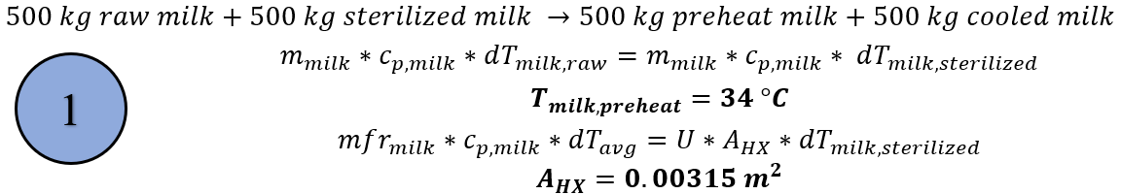
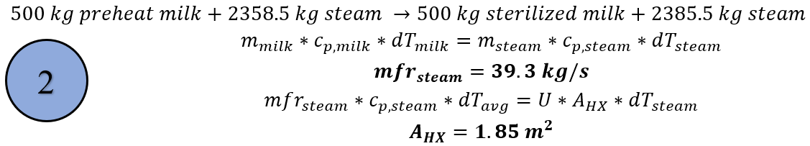
Unit Operation 1: Pasteurization
Mass and Energy Balance

Slide 8
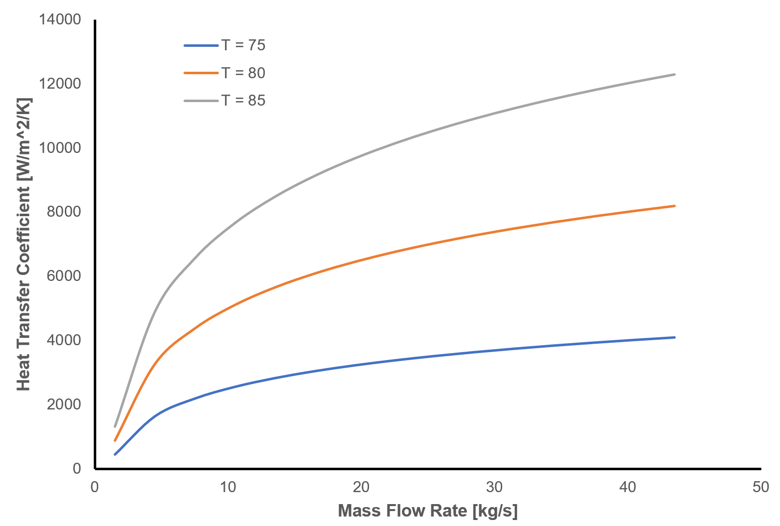
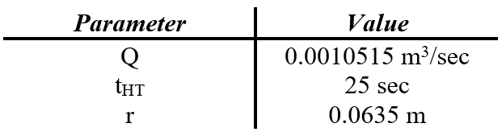
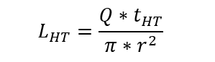
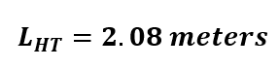
Unit Operation 1: Pasteurization
Design Equations and Performance Curve

Slide 9
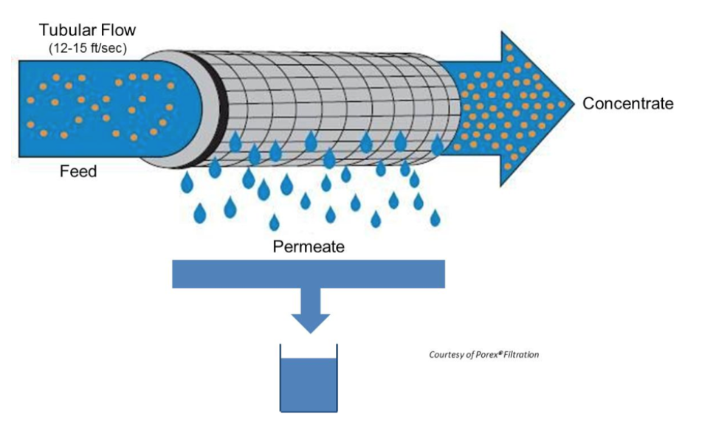
Unit Operation 2: Concentration
Goals:
Protein fractionation to remove whey & retain casein
Milk Concentration for texture enhancement
Chosen Method:
Crossflow Microfiltration
Alternatives:
Ultrafiltration - membrane pore size
Nanofiltration - membrane pore size
Centrifugation - separation of milk components by weight
Reverse Osmosis - additional water removal in conjunction with filtration
Porex Filtration Group

Slide 10
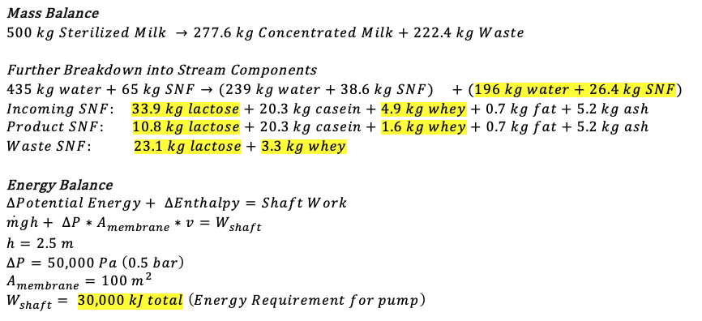
Unit Operation 2: Concentration
Mass and Energy Balances

Slide 11
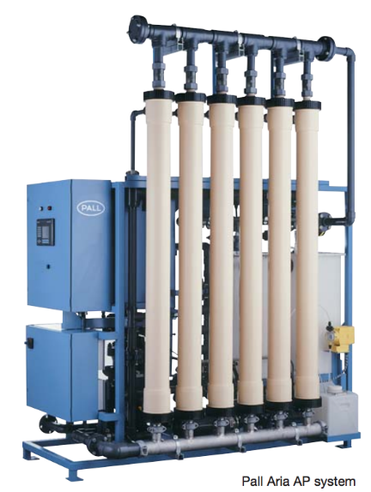
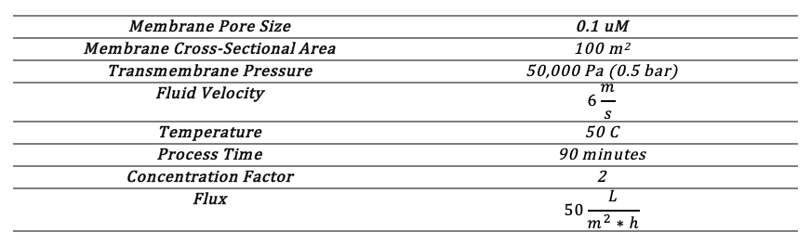
Unit Operation 2: Concentration
Design, Process, Sizing, Performance
Pall Corporation Microfiltration System

Slide 12
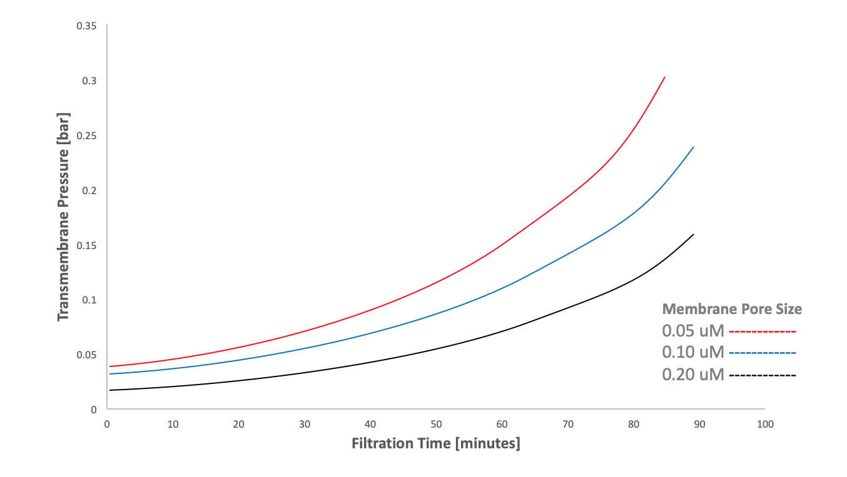
Unit Operation 2: Concentration
Performance Curve

Slide 13
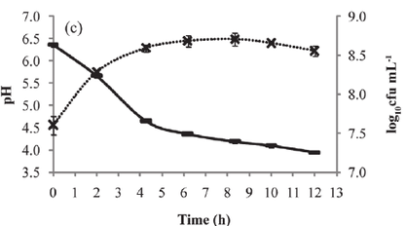
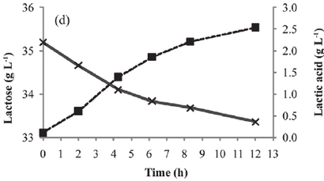
Unit Operation 3: Yogurt Fermentation
Goals:
Coagulate proteins in milk via lactic acid bacteria
Make lactic acid from lactose
Traditional Method:
Alternatives:
Santiago, G. Trujillo-De, et al. “Elaboration of a Probiotic Oblea from Whey Fermented Using Lactobacillus Acidophilus or Bifidobacterium Infantis.” Journal of Dairy Science, vol. 95, no. 12, 2012, pp. 6897–6904., doi:10.3168/jds.2012-5418.

Slide 14
Yogurt Fermentation: Goals & Alternatives
Goals:
Coagulate proteins in milk via lactic acid bacteria
Make lactic acid from lactose
Traditional Method:
Lactobacillus bulgaricus and Streptococcus thermophilus
Regular milk
Alternatives:
Vary type of bacteria
Add protein powder (to reduce need to concentrate)
Add lactose (because of loss during microfiltration)

Slide 15
Unit Operation 3: Yogurt Fermentation
Mass and Energy Balances
Overall Fermentation Mass Balance:
milk after microfiltration + starter culture + extra lactose → yogurt
277.6kg ~0kg 8kg → 285.6kg .
Lactose Mass Balance:
10.8 kg lactose (milk) 9.9 kg glucose → 9.9 kg lactic acid
+ 8 kg lactose (additive) 8.9 kg galactose
Design Equations & Energy Balance:
m_{milk}C_{p,m}T_{m}=m_{water}C_{p,w}T_{w}
277.6 kg/h * 3.93 kJ/kgK * (50-40)= m_{water} kg/h *4.1855 kJ/kgK *(10-5)
m_{water} = 521.3 kg/h
m_{water}C_{p,w}T_{w} = UAT_{ln} =10909.7 KJ/h = 3030.5 J/s
where U is ~1700 W/m²K from Geankoplis,
A = 0.098 m²

Slide 16
Unit Operation 3: Yogurt Fermentation
Process and Equipment Sizing
Milk from microfiltration
Starter Culture
Extra Lactose
Temperature: 40C (controlled by water jacket)
Vessel volume: 2000L
Fermentation, fill, or empty time: 6 hours
Pre-fermentation heat exchanger: A = 0.098 m²
Post-fermentation heat exchanger: A = 1.87 m²
Fill
Ferment
Empty
Yogurt to spray drying

Slide 17
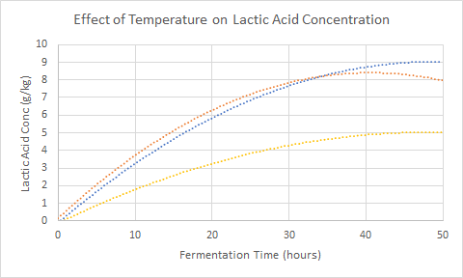
Unit Operation 3: Yogurt Fermentation
Performance Curve
37C
45C
30C

Slide 18
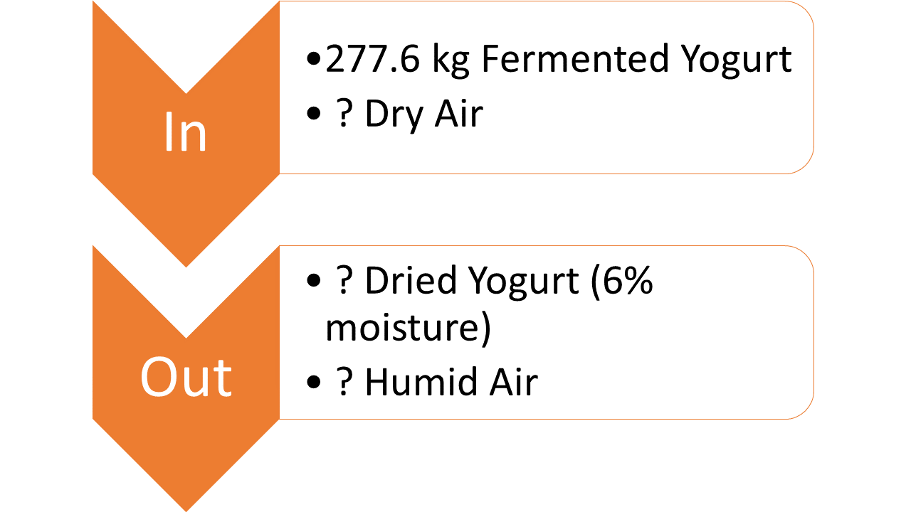
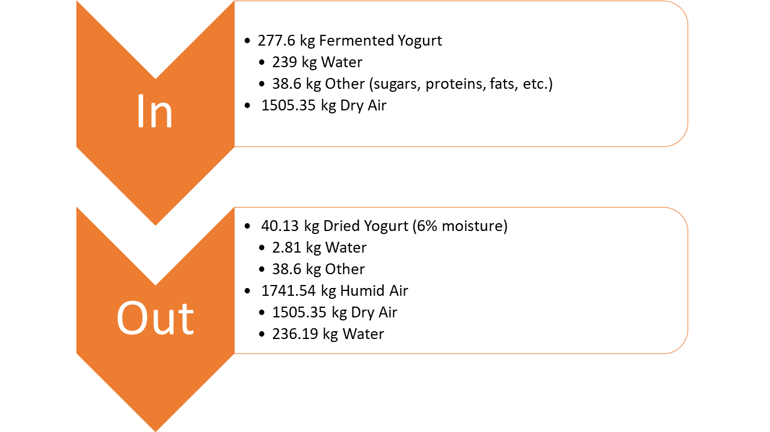
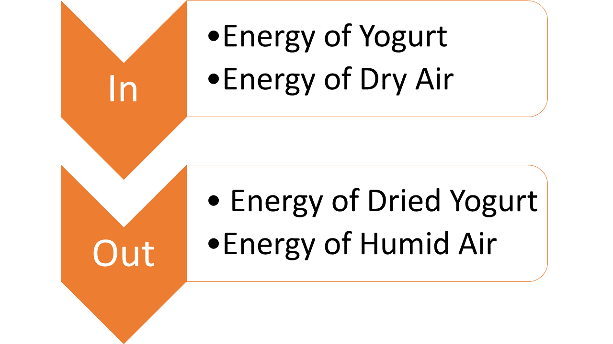
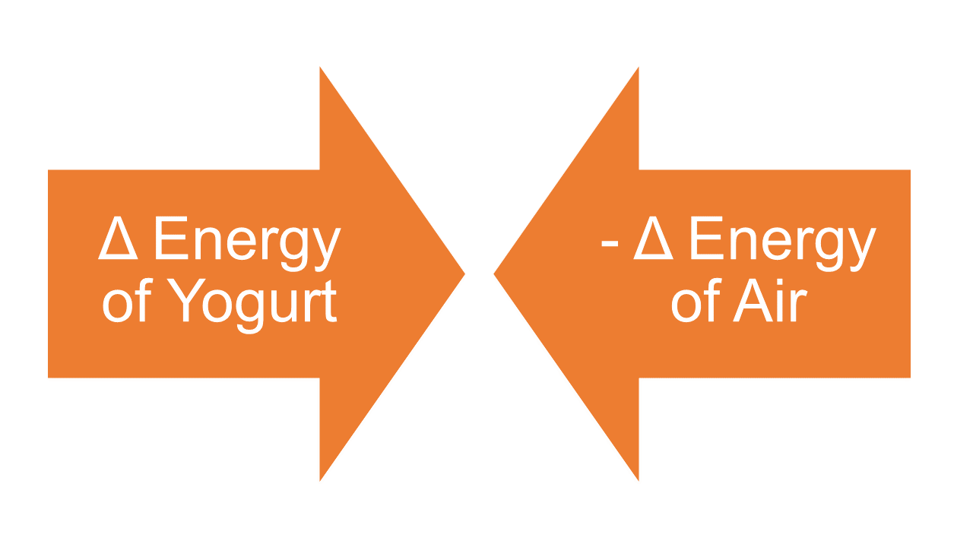
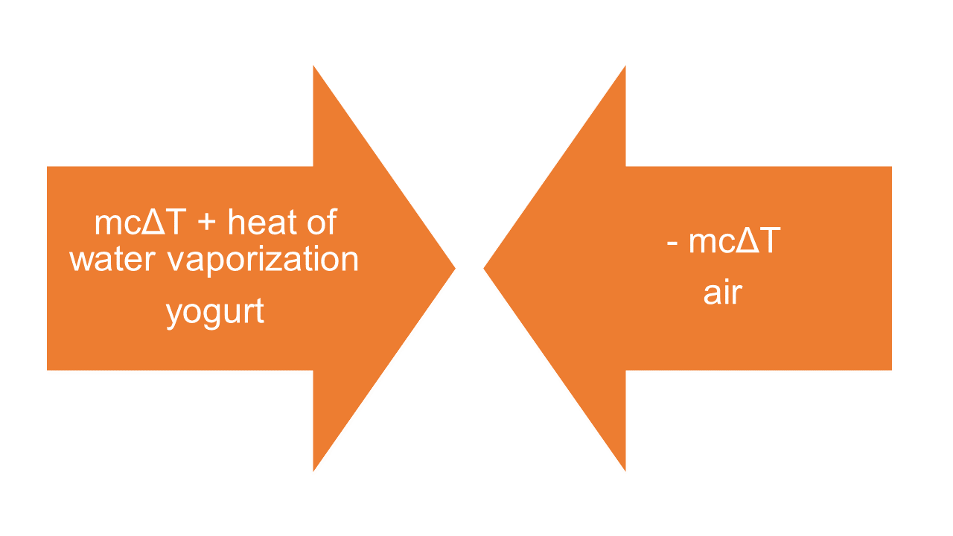
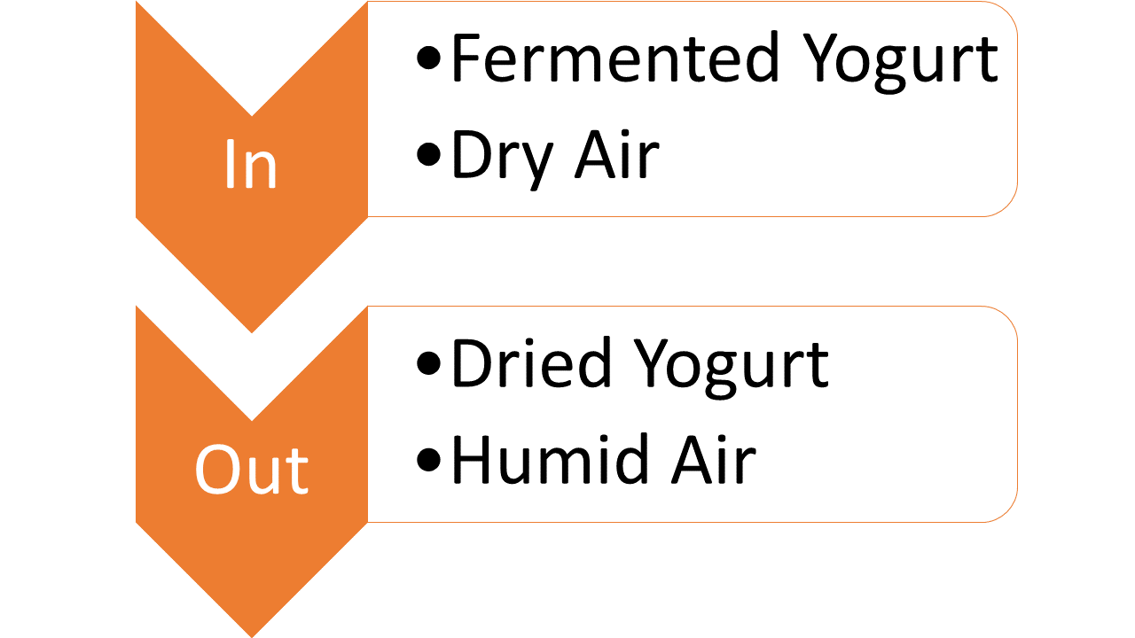
Unit Operation 4: Spray Drying
Most viable alternative: Freeze drying
Best retention of bacterial survival
Lower temperature than spray drying
Expensive
Goal: remove moisture from the yogurt to increase shelf life and stability of the final product with minimal damage to the microstructure of the yogurt.
Relatively high rate of survival of bacteria
Industry standard process for dairy products
Cost-effective
Retains color and taste generally well
High temperature process
Mass Balance Result:
Remove 236.19 kg water
Require 1505.35 kg dry air (Psychrometrics, initial and final temperatures and humidities)
Energy Balance Result:
Final temperature of the yogurt is 40ºC

Slide 19
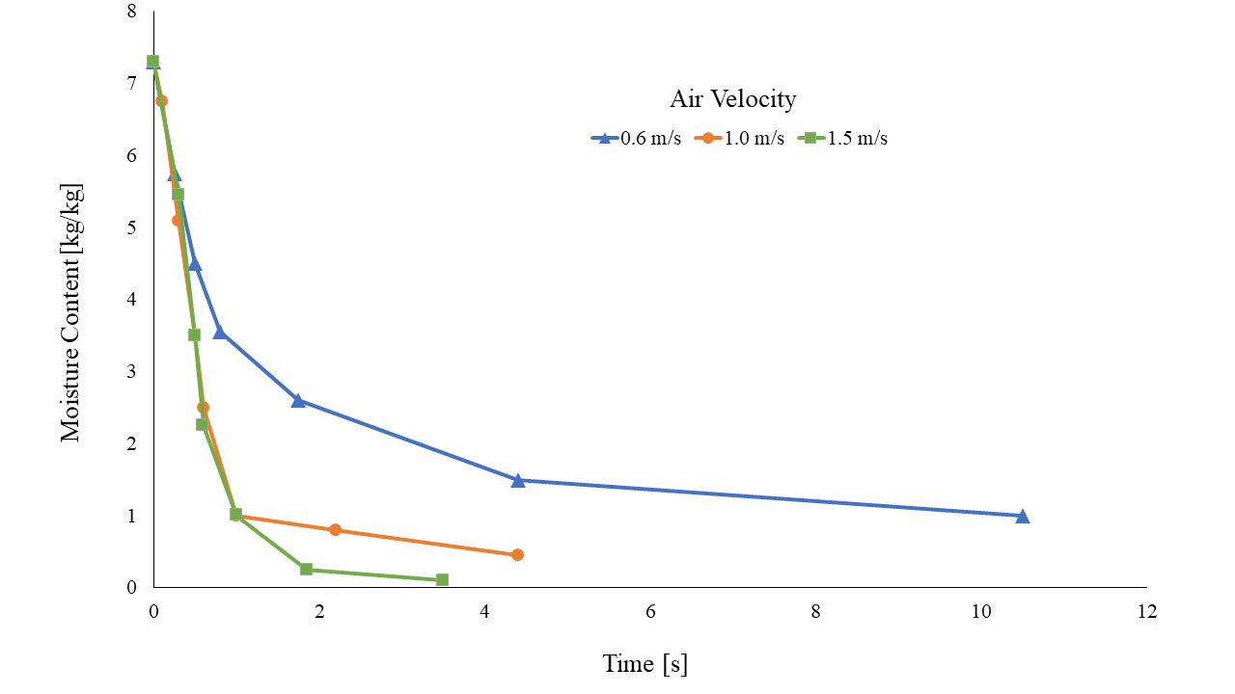
Design and Process and Equipment Sizing
Processing 277.6 kg yogurt per hour
Residence time of each particle in the dryer is ~10 seconds
Based on mass of air (mass balance):
V_{dryer} = 204.73 m³
Should be as tall as reasonably possible to increase residence time and thus decrease final moisture content
D = 5 m; H = 10.43 m (cylindrical)
From this performance curve, we should design the system such that the air velocity is high to decrease the required residence time.

Slide 20
EXPERIMENTATION

Slide 21
Plackett-Burman DOE
Variables | Temp of Fermentation | Concentration of Starter Culture | Fermenter Height:D Ratio | Fermentation Ending pH | Amount of Added Lactose | Amount of added Protein Powder | Time in Holding Tube | Temp of Concentration | Filter Pore Size | Protein Concentration after Conc | Membrane Flux | Dryer Air Velocity | Dryer Inlet Air Temperature | Droplet Size | Dryer Inlet Yogurt Temp | Dryer Residence Time | Dummy 17 | Dummy 18 | Dummy 19
Runs (#variables +1)
1 | 1 | 1 | 1 | 1 | 1 | 1 | 1 | 1 | 1 | 1 | 1 | 1 | 1 | 1 | 1 | 1 | 1 | 1 | 1
2 | -1 | 1 | -1 | -1 | 1 | 1 | 1 | 1 | -1 | 1 | -1 | 1 | -1 | -1 | -1 | -1 | 1 | 1 | -1
3 | -1 | -1 | 1 | -1 | -1 | 1 | 1 | 1 | 1 | -1 | 1 | -1 | 1 | -1 | -1 | -1 | -1 | 1 | 1
4 | 1 | -1 | -1 | 1 | -1 | -1 | 1 | 1 | 1 | 1 | -1 | 1 | -1 | 1 | -1 | -1 | -1 | -1 | 1
5 | 1 | 1 | -1 | -1 | 1 | -1 | -1 | 1 | 1 | 1 | 1 | -1 | 1 | -1 | 1 | -1 | -1 | -1 | -1
6 | -1 | 1 | 1 | -1 | -1 | 1 | -1 | -1 | 1 | 1 | 1 | 1 | -1 | 1 | -1 | 1 | -1 | -1 | -1
7 | -1 | -1 | 1 | 1 | -1 | -1 | 1 | -1 | -1 | 1 | 1 | 1 | 1 | -1 | 1 | -1 | 1 | -1 | -1
8 | -1 | -1 | -1 | 1 | 1 | -1 | -1 | 1 | -1 | -1 | 1 | 1 | 1 | 1 | -1 | 1 | -1 | 1 | -1
9 | -1 | -1 | -1 | -1 | 1 | 1 | -1 | -1 | 1 | -1 | -1 | 1 | 1 | 1 | 1 | -1 | 1 | -1 | 1
10 | 1 | -1 | -1 | -1 | -1 | 1 | 1 | -1 | -1 | 1 | -1 | -1 | 1 | 1 | 1 | 1 | -1 | 1 | -1
11 | -1 | 1 | -1 | -1 | -1 | -1 | 1 | 1 | -1 | -1 | 1 | -1 | -1 | 1 | 1 | 1 | 1 | -1 | 1
12 | 1 | -1 | 1 | -1 | -1 | -1 | -1 | 1 | 1 | -1 | -1 | 1 | -1 | -1 | 1 | 1 | 1 | 1 | -1
13 | -1 | 1 | -1 | 1 | -1 | -1 | -1 | -1 | 1 | 1 | -1 | -1 | 1 | -1 | -1 | 1 | 1 | 1 | 1
14 | 1 | -1 | 1 | -1 | 1 | -1 | -1 | -1 | -1 | 1 | 1 | -1 | -1 | 1 | -1 | -1 | 1 | 1 | 1
15 | 1 | 1 | -1 | 1 | -1 | 1 | -1 | -1 | -1 | -1 | 1 | 1 | -1 | -1 | 1 | -1 | -1 | 1 | 1
16 | 1 | 1 | 1 | -1 | 1 | -1 | 1 | -1 | -1 | -1 | -1 | 1 | 1 | -1 | -1 | 1 | -1 | -1 | 1
17 | 1 | 1 | 1 | 1 | -1 | 1 | -1 | 1 | -1 | -1 | -1 | -1 | 1 | 1 | -1 | -1 | 1 | -1 | -1
18 | -1 | 1 | 1 | 1 | 1 | -1 | 1 | -1 | 1 | -1 | -1 | -1 | -1 | 1 | 1 | -1 | -1 | 1 | -1
19 | -1 | -1 | 1 | 1 | 1 | 1 | -1 | 1 | -1 | 1 | -1 | -1 | -1 | -1 | 1 | 1 | -1 | -1 | 1
20 | 1 | -1 | -1 | 1 | 1 | 1 | 1 | -1 | 1 | -1 | 1 | -1 | -1 | -1 | -1 | 1 | 1 | -1 | -1

Slide 22
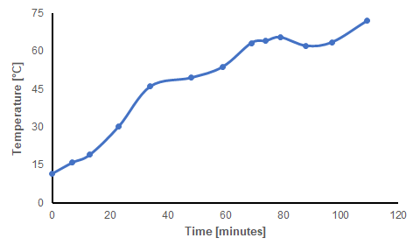
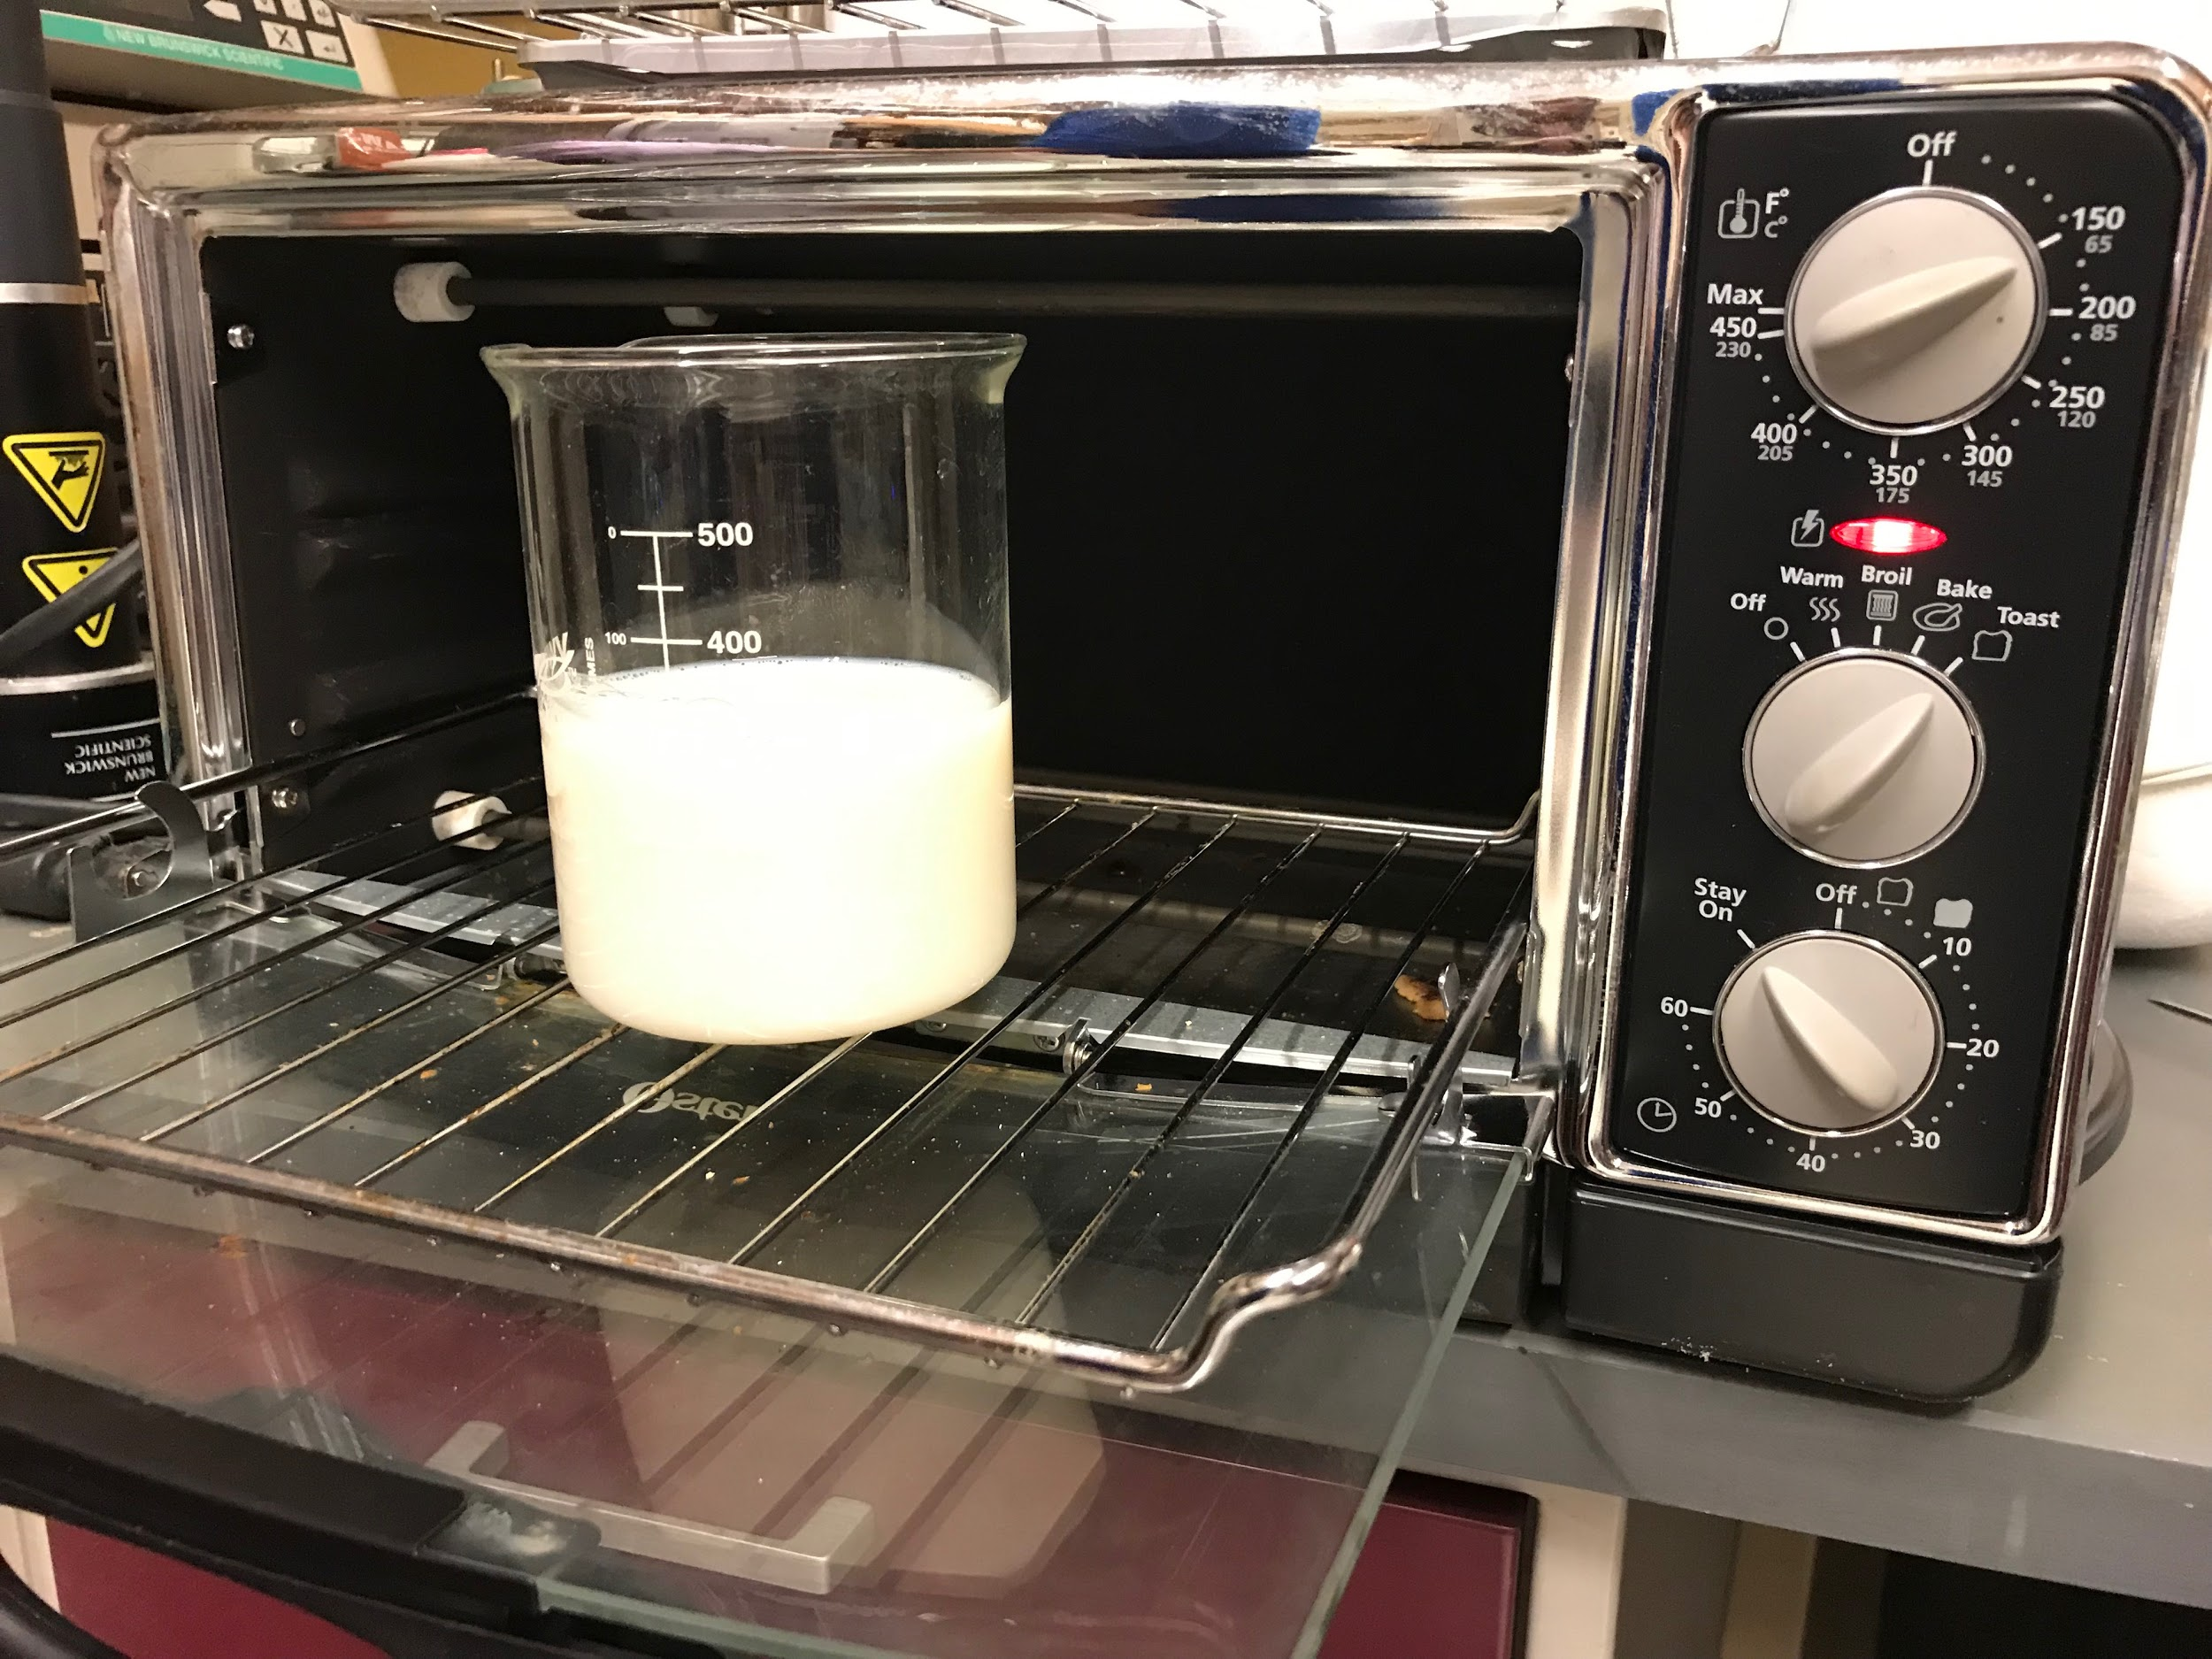
Pasteurization Experimentation
Batch system to 65 ℃ for 30 minutes
Difficulty maintaining temperature
Inconsistent heat transfer

Slide 23
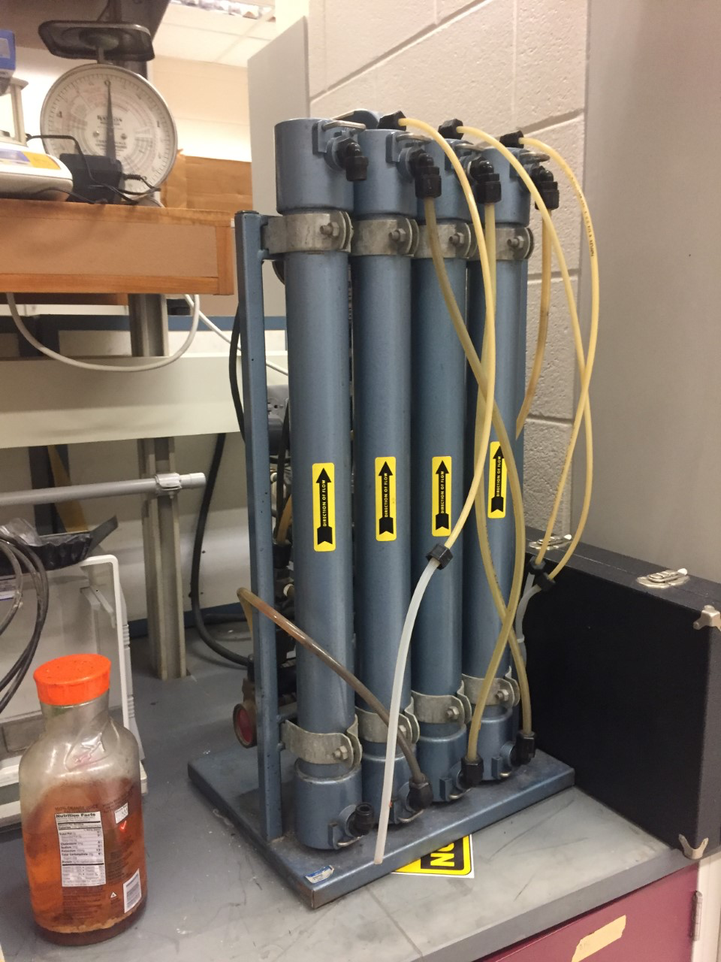
Concentration Experimentation
Protein Quantification: Kjeldahl Method [Nitrogen Composition of Fluid]
Protein Fractionation: SDS-Page Gel / Chromatography
Okos’ Microfiltration System

Slide 24
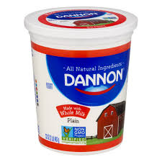

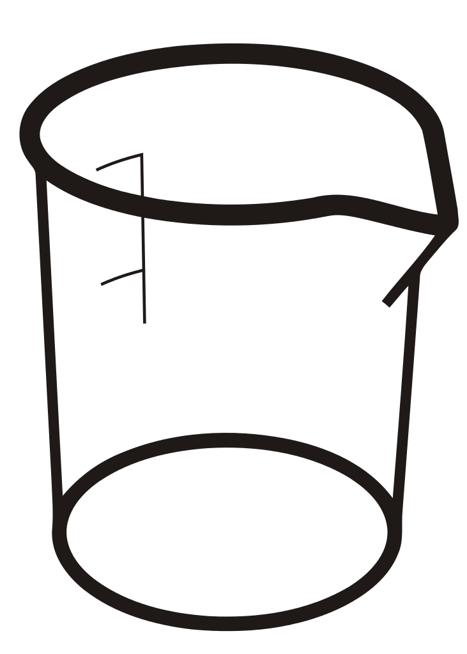
Yogurt Fermentation Experimentation: Initial pH
4.41
5.19
5.40
5.75
5.90
6.10
6.42
6.80
Notes:
Used Dannon live cultures as starter
Didn’t have 6 hours so similuated fermentation at different extents in 2-hour period

Slide 25
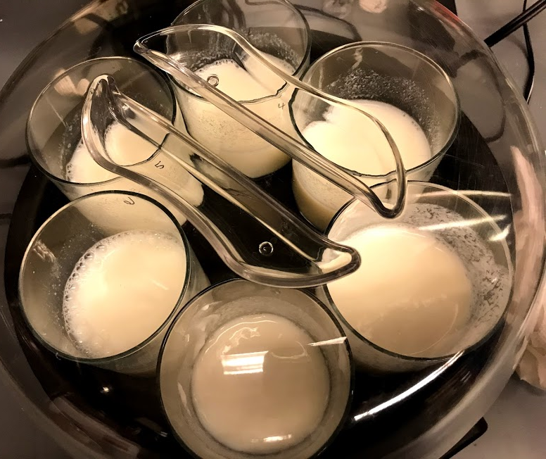
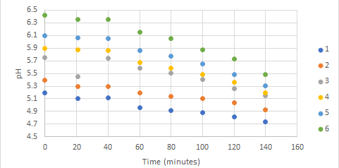
Yogurt Fermentation: Beaker pH Profiles
Power usage: 140 J for a 2 hour batch process

Slide 26
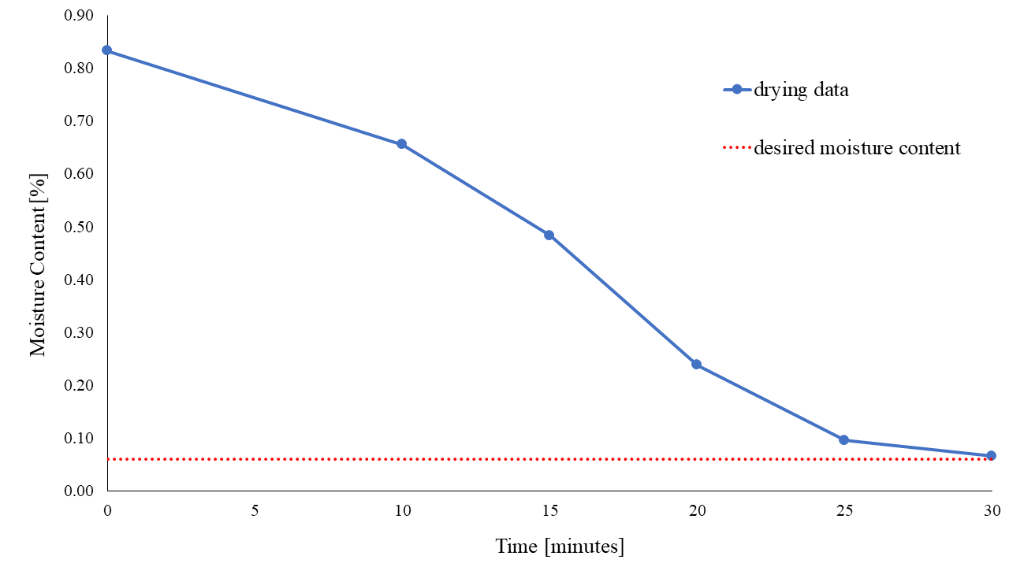
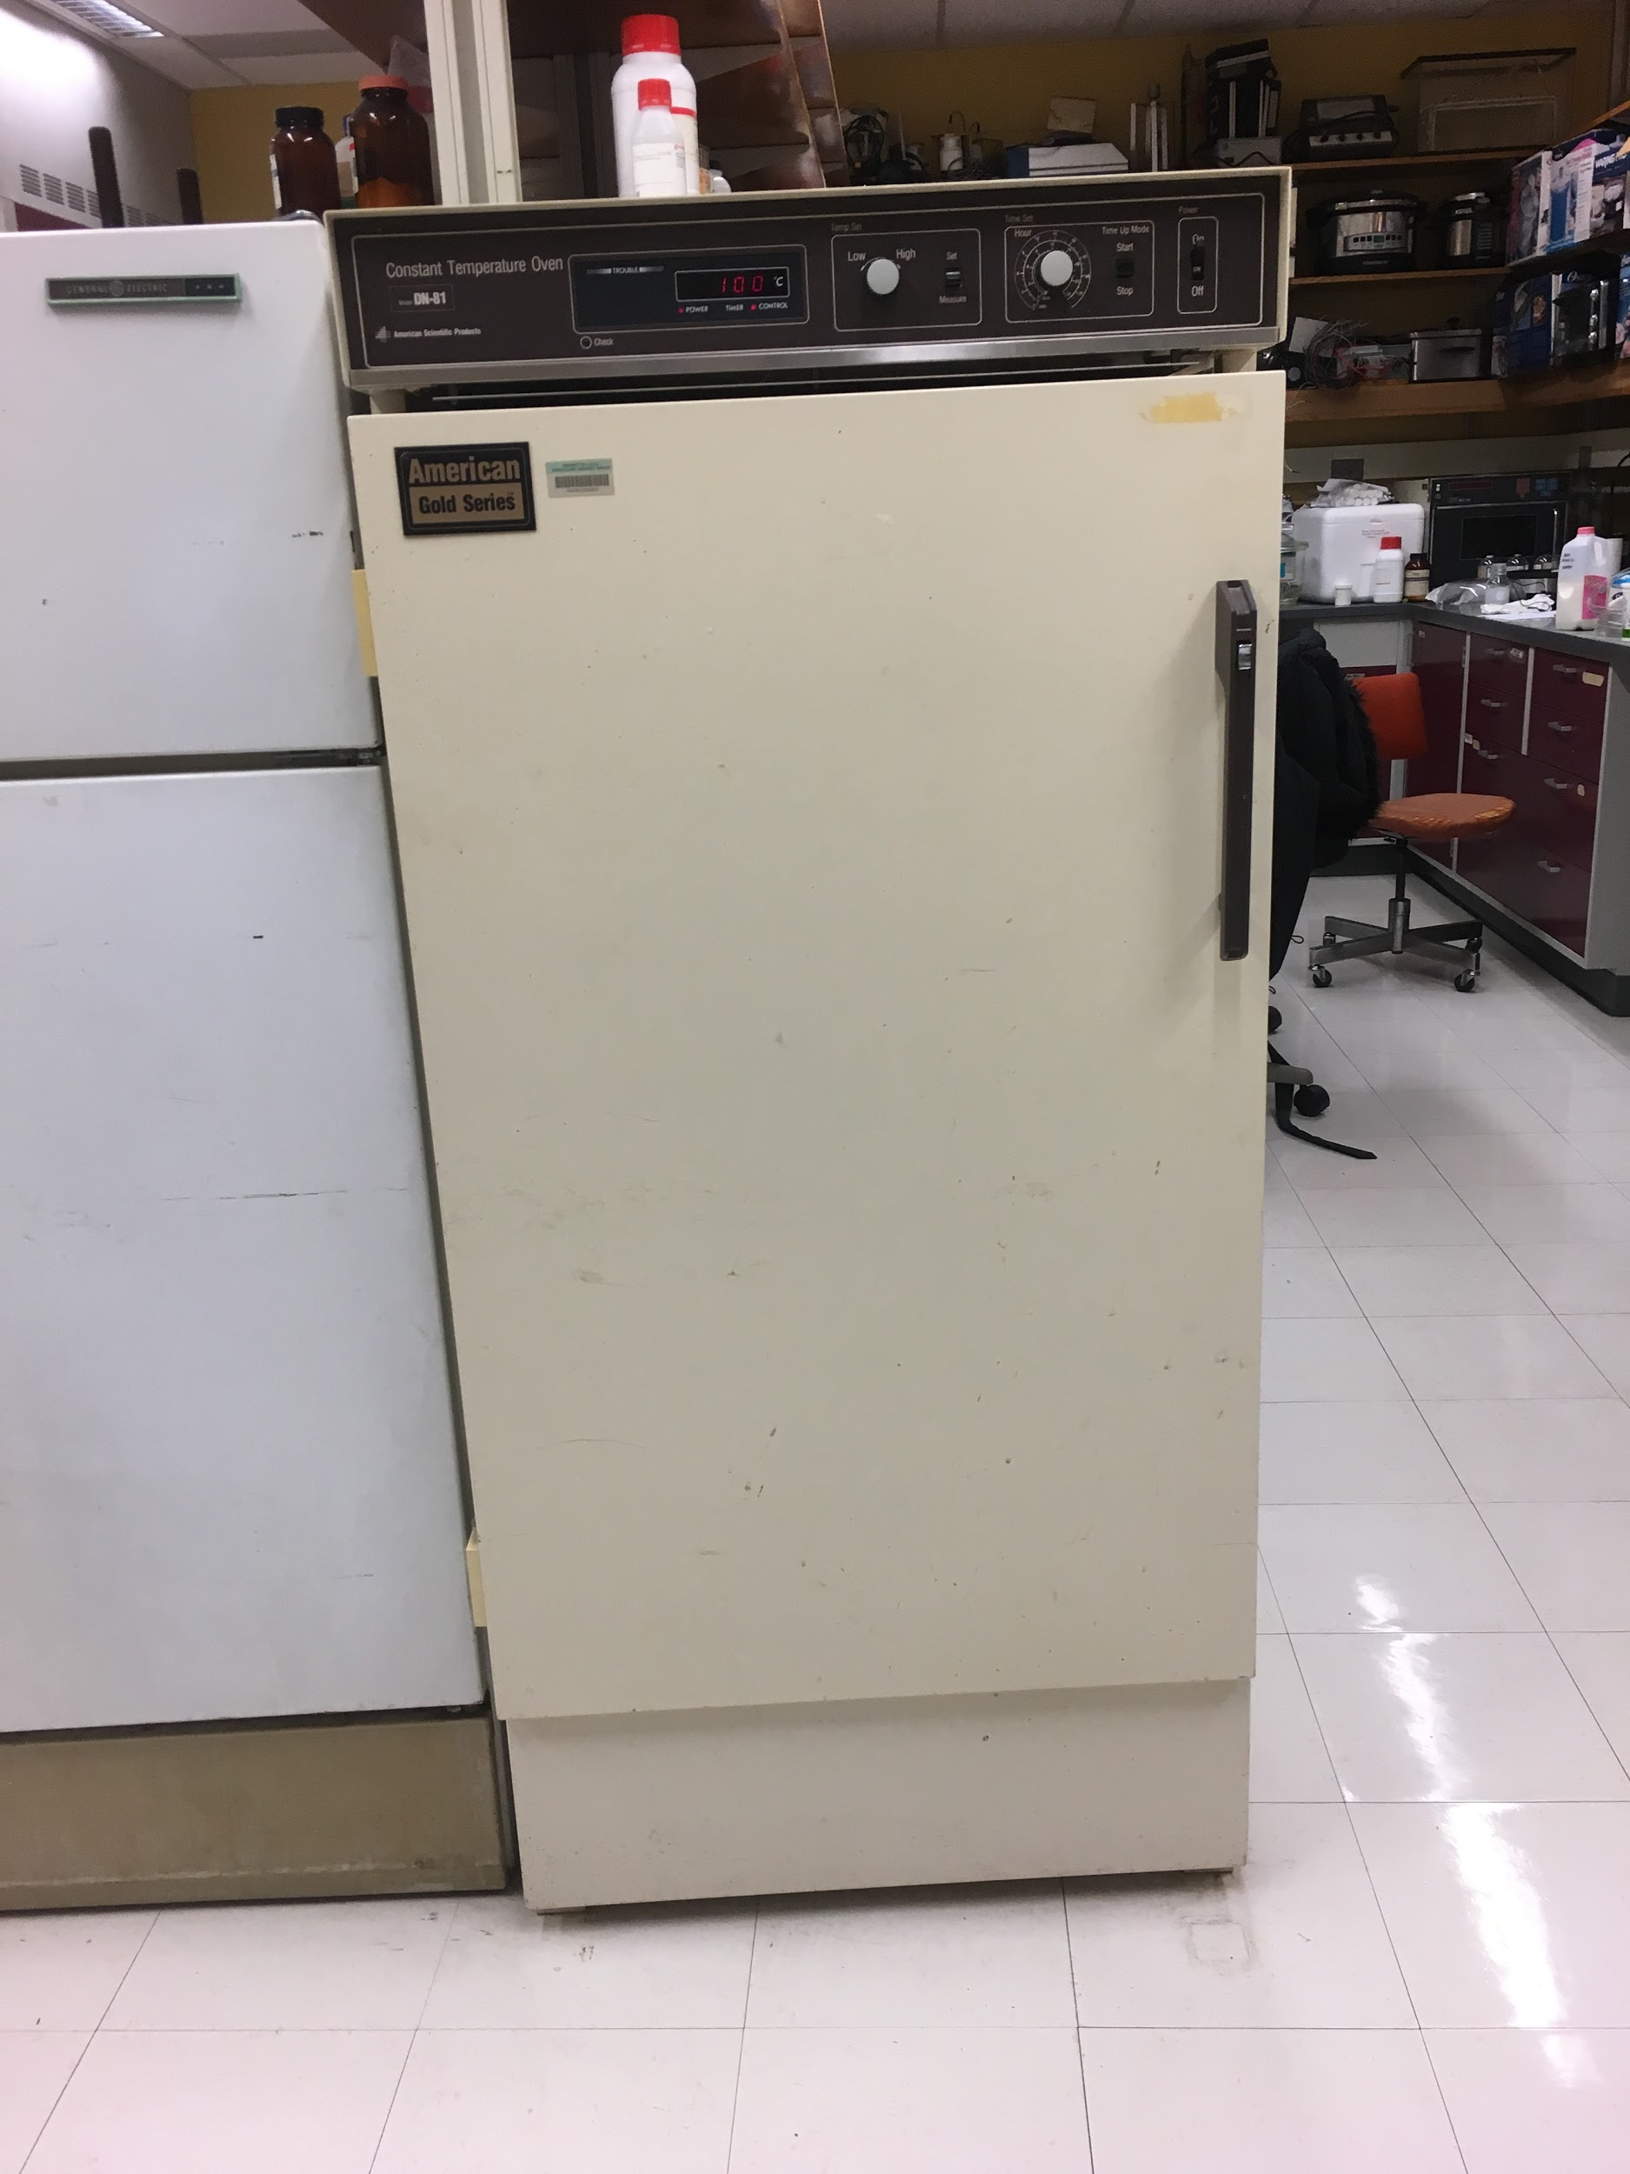
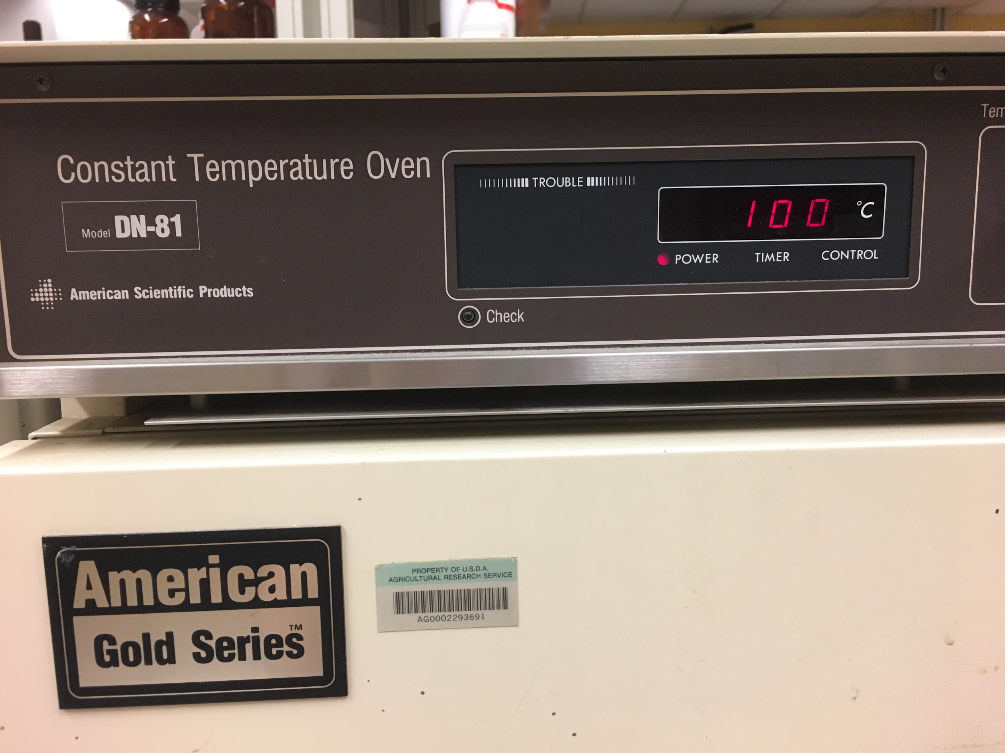
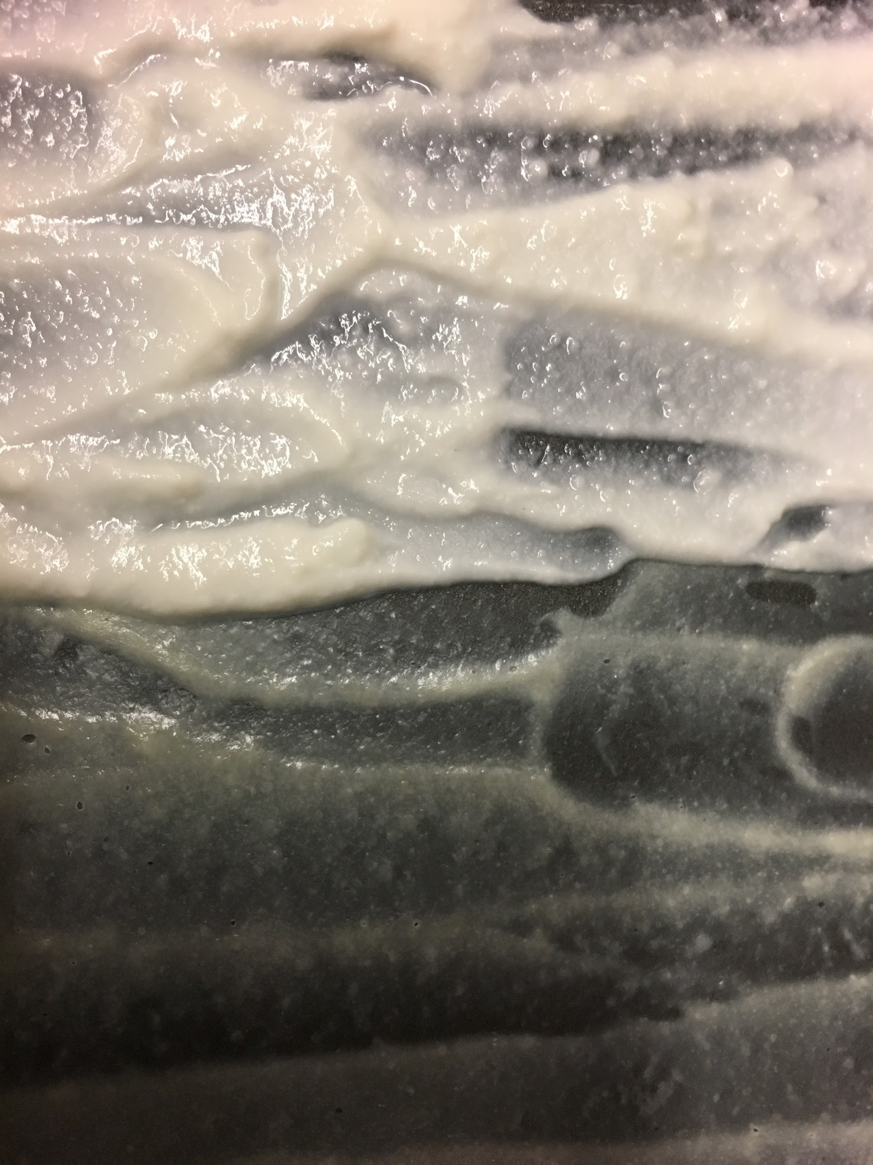
before
after
Drying Experimentation
and Results

Slide 27
CONCLUSIONS AND FUTURE DIRECTIONS

Slide 28
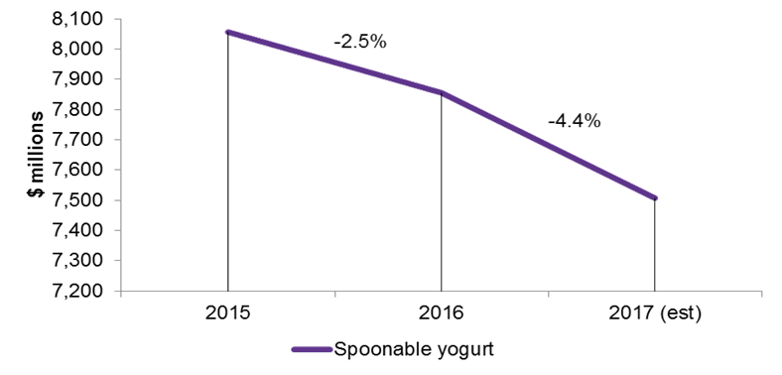
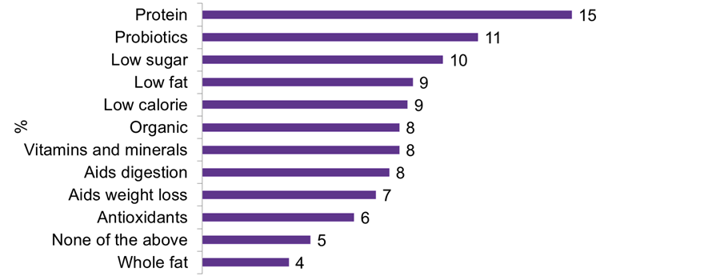
Industry Trends and Market Size

Slide 29
Sustainability, Ethical, Global, and Societal Issues
Processing:
Final Product:
Access to probiotics and animal proteins
Dried product allows easier transport
Acid Whey Generation
Pre-Fermentation Concentration
Water Consumption
Pasteurization - Milk Regeneration
Fermentation - Water jacket reuses water from earlier in the process for heat exchange

Slide 30
Moving into Next Semester . . .
Accurate equipment for processing
Bacterial cultures
Scaling up to pilot

Slide 31
THANK YOU AND SEE YOU NEXT YEAR

Slide 32
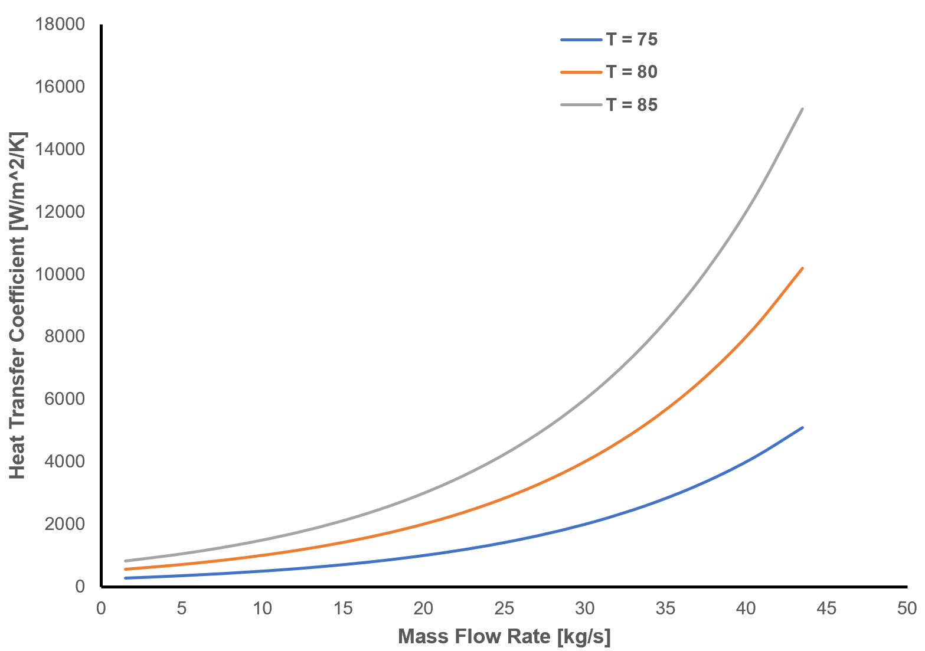
Unit Operation 1: Pasteurization
Overall Goal: Removes pathogens and enzymes that degrade a product
✔
Heat Treatment: high temperature causes protein breakdown
Hydrostatic Pressure Processing: breaking of ionic bonds with high pressure
UV Light: breaks bonds in DNA by causing thymine dimers
Pulsed Electric Field: adds a potential difference causing loss of cell permeability

